Slide 1
ALGEBRA 4
Day 49

Slide 2
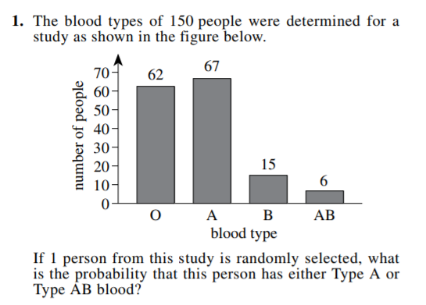
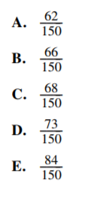
Bell Work

Slide 3
From Last Time
Page 308 #1-7, 11-25 (odd), 29, 33-37 (odd), 41
(Extra Practice #44-62)

Slide 4
5.6 The Fundamental Theorem of Algebra
Objective(s): To use the Fundamental Theorem of Algebra to solve polynomial equations with and without complex solutions.

Slide 5
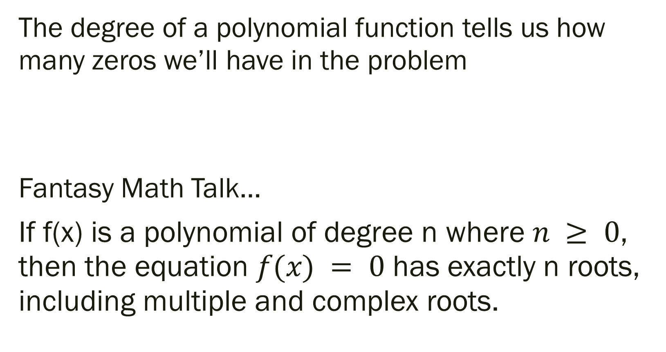
The Fundamental Theorem of Algebra
The degree of a polynomial function tells us how many zeros we’ll have in the problem
Fantasy Math Talk…
If f(x) is a polynomial of degree n where $n ≥ 0$, then the equation $f(x) = 0$ has exactly n roots, including multiple and complex roots.

Slide 6
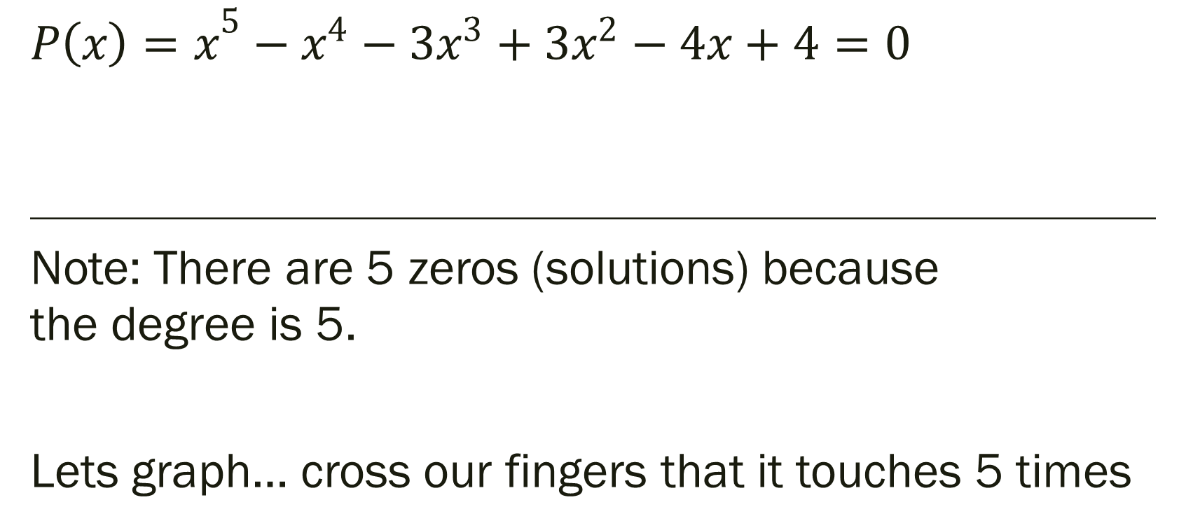
What are the roots for the following equation?
$${P\left(x\right)=x}^{5}−x^{4}−3x^{3}+3x^{2}−4x+4=0$$
_____________________________________________________________________________
Note: There are 5 zeros (solutions) because the degree is 5.
Lets graph… cross our fingers that it touches 5 times

Slide 7
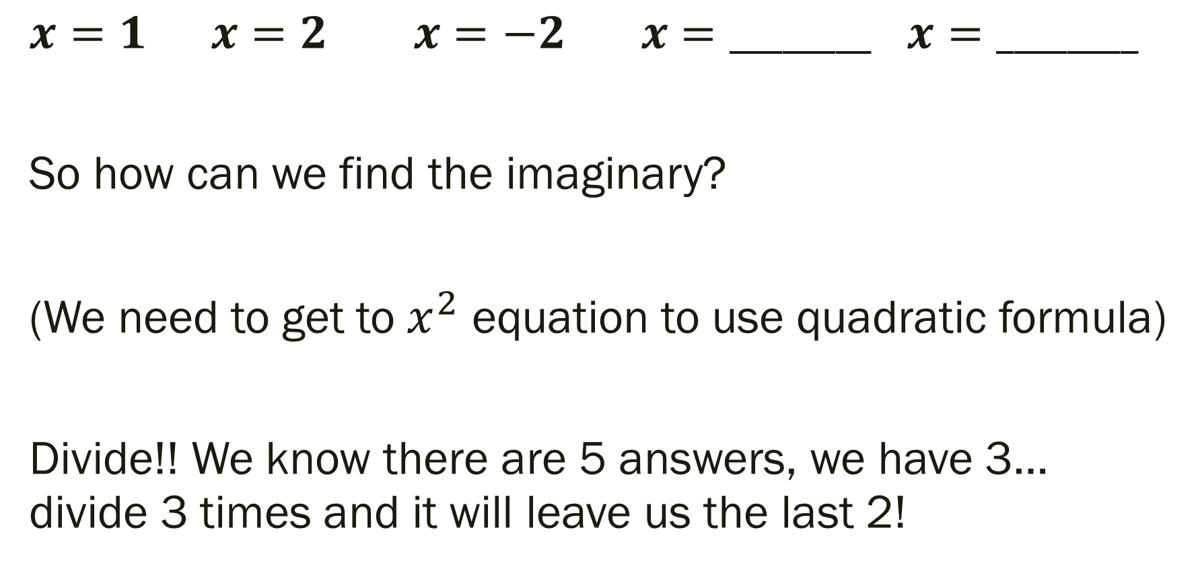
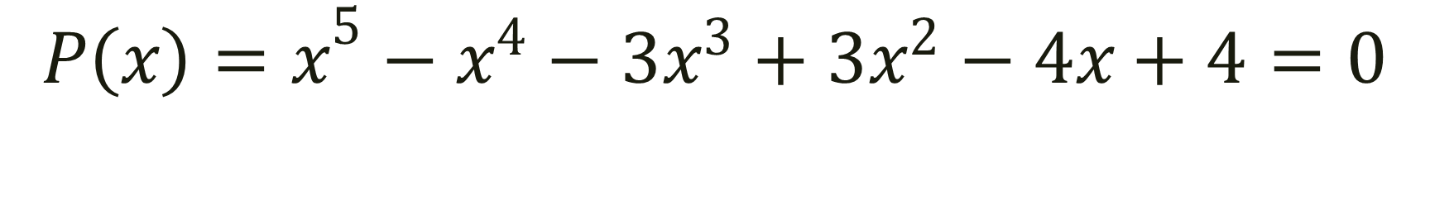
$${P\left(x\right)=x}^{5}−x^{4}−3x^{3}+3x^{2}−4x+4=0$$
$x=1 x=2 x=−2 x=________$ $x=________$
So how can we find the imaginary?
(We need to get to $x^{2}$ equation to use quadratic formula)
Divide!! We know there are 5 answers, we have 3… divide 3 times and it will leave us the last 2!

Slide 8
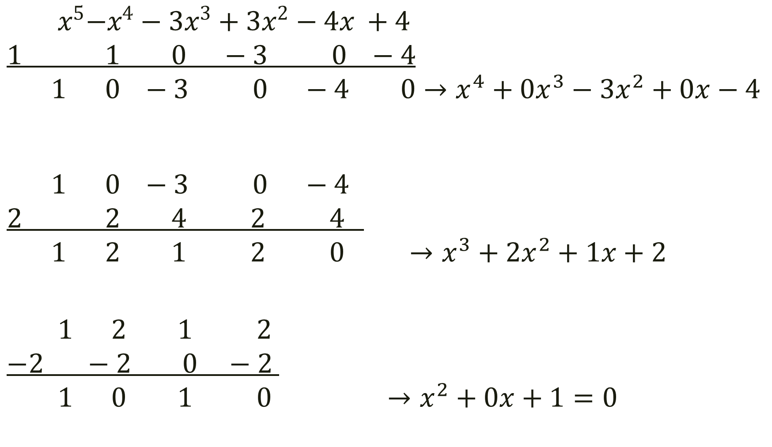
$${ x}^{5}−x^{4}−3x^{3}+3x^{2}−4x +4$$
$$1 1 0 −3 0 −4$$
$$1 0 −3 0 −4 0→x^{4}+0x^{3}−3x^{2}+0x−4$$
$$1 0 −3 0 −4$$
$$2 2 4 2 4$$
$$1 2 1 2 0 →x^{3}+2x^{2}+1x+2$$
$$1 2 1 2$$
$$−2 −2 0 −2$$
$$1 0 1 0 →x^{2}+0x+1=0$$

Slide 9

$${P\left(x\right)=x}^{5}−x^{4}−3x^{3}+3x^{2}−4x+4=0$$
Use quadratic formula to find the last two zeros…
$x=1 x=2 x=−2 x=i x=−i$

Slide 10

More Examples
$x^{5}−x^{4}−7x^{3}+7x^{2}−18x+18=0$
$x^{4}+2x^{3}−4x^{2}−7x−2=0$

Slide 11
For Next Time
page 322 #1-7, 9-19 (odd), 38-40, 44

